Slide 1
Health values:
Exactly what they say on the tin
(Except not always and quite rarely)
@ACTually_Alyson

Slide 2
Instructions
Pair the health value with the congruent behaviour
@ACTually_Alyson

Slide 3
Pair the health value with the congruent behaviour
Health Value: Longevity
Eating well & staying active
Smoking
1/3
@ACTually_Alyson

Slide 4
If you selected #1 (eating well & staying active)…
Ding dong you’re wrong.
Although topographically congruent not functionally congruent for this person…
1/3
@ACTually_Alyson

Slide 5
Pair the health value with the congruent behaviour
Health Value: Fun
Participating in The Follies
Untangling Christmas lights
2/3
@ACTually_Alyson

Slide 6
If you selected #1 (participating in The Follies)…
Ding dong you’re wrong.
Although topographically congruent not functionally congruent for this person…
2/3
@ACTually_Alyson

Slide 7
Pair the health value with the congruent behaviour
Health Value: Fitness
Working out at the gym
Participating in a hot dog eating contest
3/3
@ACTually_Alyson

Slide 8
If you selected #1 (working out at the gym)…
Ding dong you’re wrong.
Although topographically congruent not functionally congruent for this person…
3/3
@ACTually_Alyson

Slide 9
“functional congruence tops topographical congruence”
@ACTually_Alyson

Slide 10
Some empirical basis for this…
Participants
111 adults aged 18-49 (M = 21.41, SD = 3.721) (female = 69; male = 40; non-binary = 1; other = 1)
Self-reported HEALTH VALUES directedness, physical activity, dietary quality, sleep quality, & alcohol consumption.
@ACTually_Alyson

Slide 11
Measuring HEALTH VALUES Directedness…
Using a values card sort task
HEALTH VALUES cards only
Exertion Resilience Self-Care Discipline
Ability Functioning Freedom Fun
Intimacy Beauty Immunity Leisure Longevity Strength Energy Physicality
Stimulation Fertility Sporting Striving
Balance Nutrition Fitness Stamina
@ACTually_Alyson

Slide 12
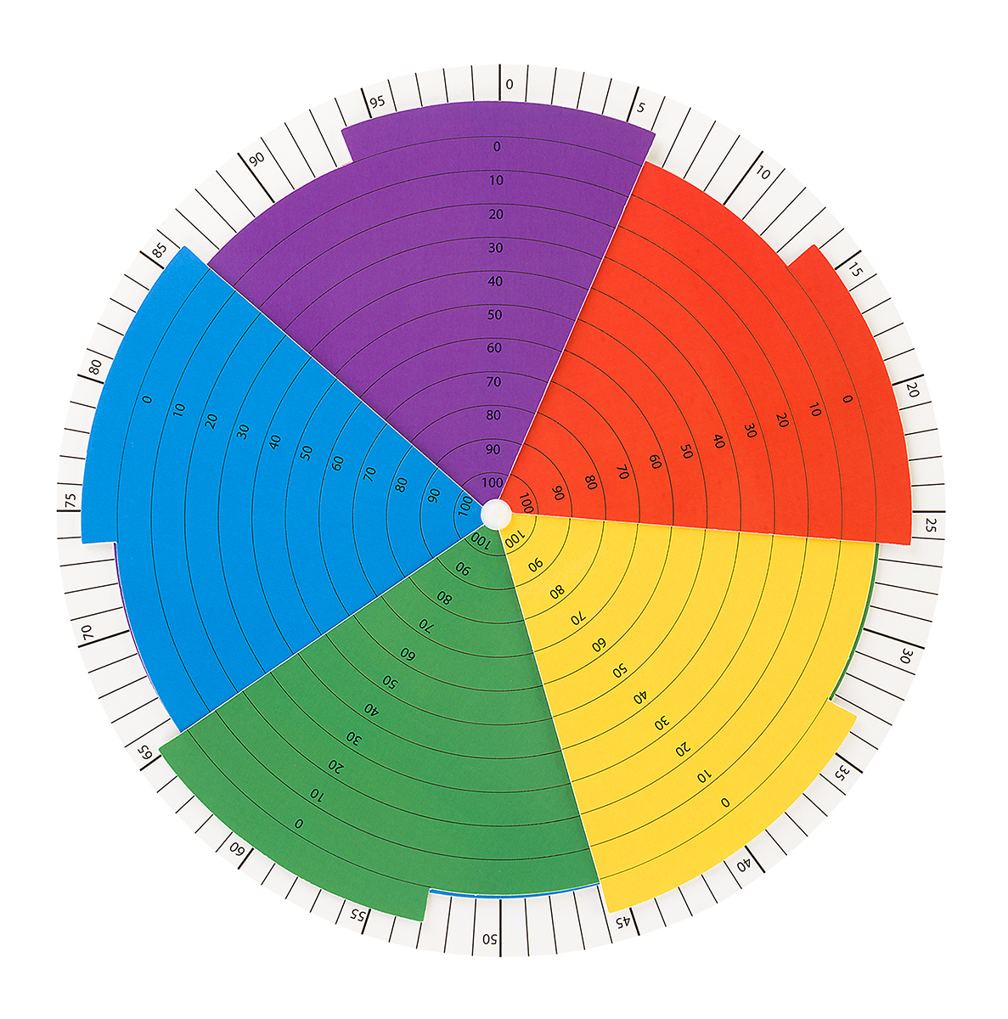
Measuring HEALTH VALUES Directedness…
O’Connor, M., Tennyson, A., Timmons, M., & McHugh, L. (2019). The development and preliminary psychometric properties of the Values Wheel. JCBS, 12, 39-46.
@ACTually_Alyson

Slide 13
Measuring Health Behaviours…
Physical activity
International Physical Activity Questionnaire
Dietary quality
Dietary Quality Tool
Sleep quality
Pittsburgh Sleep Quality Index
Alcohol consumption
Quick Drinking Screen
@ACTually_Alyson

Slide 14
Observed relationships between health values directedness & engagement in health behaviours…
No relationship between HEALTH VALUES directedness and:
Physical activity, $r_{s}$ = .166, p = .061
Dietary quality, $r_{s}$ = .089, p = .186
Alcohol consumption, $r_{s}$ = -.014, p = .495.
BUT
HEALTH VALUES directedness was related to sleep quality
$r_{s}$ = .214, p = .016
@ACTually_Alyson

Slide 15
Summarizing health values directedness & engagement in health behaviours…
So basically HEALTH VALUES directedness wasn’t related to physical activity, dietary quality or alcohol consumption.
BUT HEALTH VALUES directedness was (weakly) related to sleep quality
@ACTually_Alyson

Slide 16
“functional congruence tops topographical congruence”
@ACTually_Alyson

Slide 17
Bearing all this in mind…
let’s try one last time.
Instructions
Pair the health value with the congruent behaviour
@ACTually_Alyson

Slide 18
Pair the health value with the congruent behaviour
Health Value: Peacefulness
Sleeping
Attending a metal concert
@ACTually_Alyson

Slide 19
If you selected #2 (attending a metal concert)…
Ding dong you’re wrong.
Sometimes health values are exactly what they say on the tin.
@ACTually_Alyson

Slide 20
Thank you
@ACTually_Alyson

